Slide 1
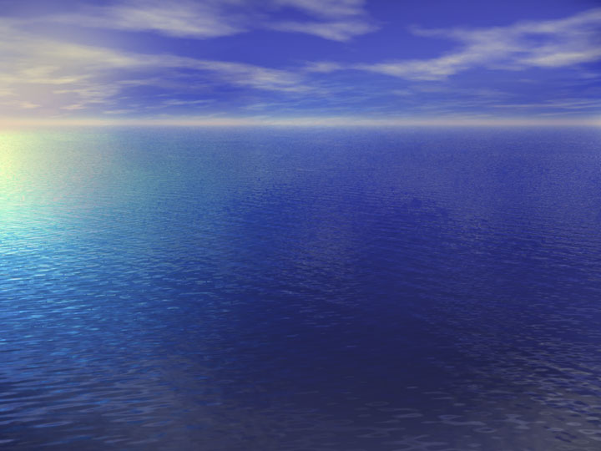
Density Calculation

Slide 2
Definition of Fluid Density
The total mass per unit volume
(Mass of Liquid + Mass of Solids)/volume

Slide 3
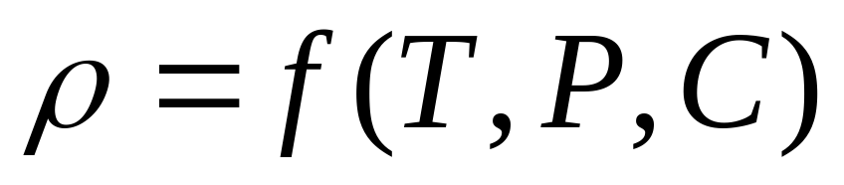
In General, fluid density is a function of temperature, pressure and solute concentrations:

Slide 4
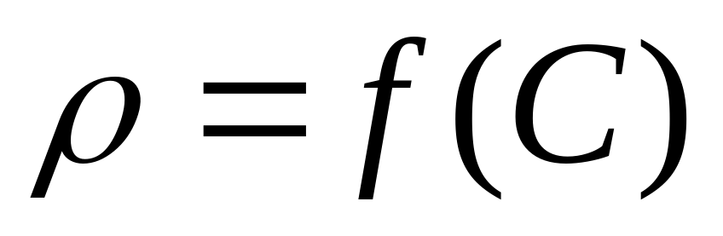
Under isothermal conditions, and assuming the fluid is incompressible, fluid density is a function of solute concentrations:

Slide 5
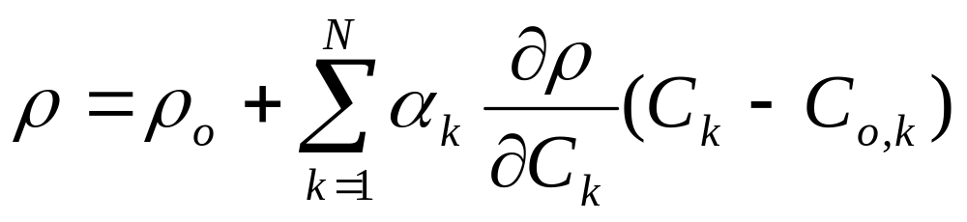

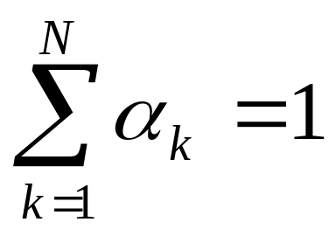
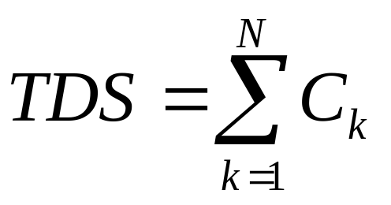
A General Form of Fluid Density

Slide 6
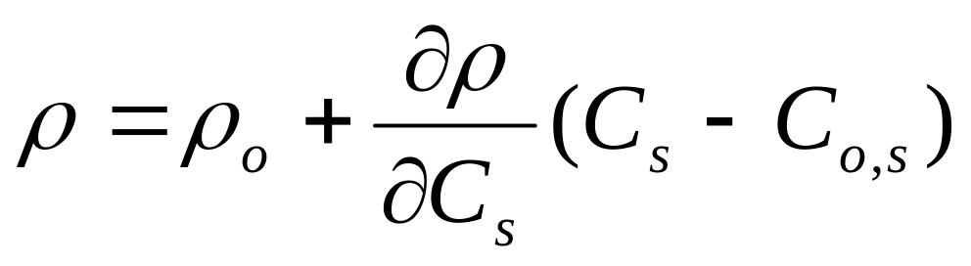

Slide 7
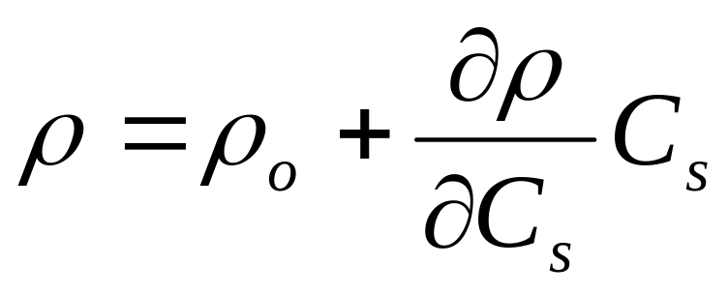
Assuming C_{o,s}=0

Slide 8
Lab Measurements of Fluid Density and Concentraions
Baxter, et al. 1911

Slide 9
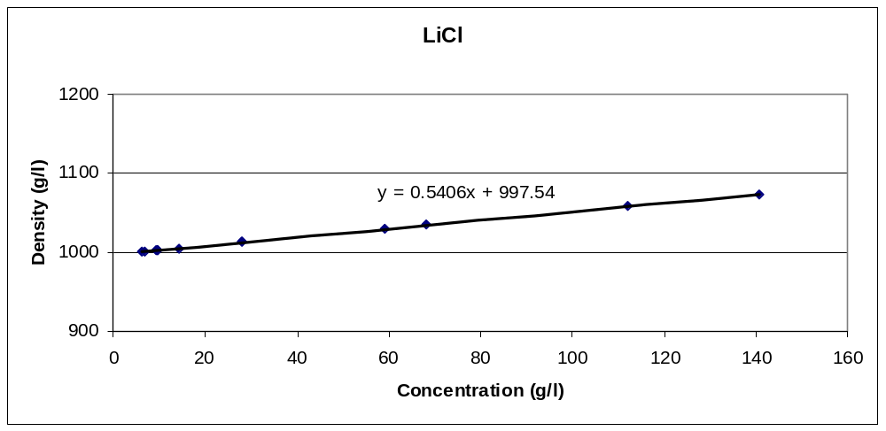

Slide 10
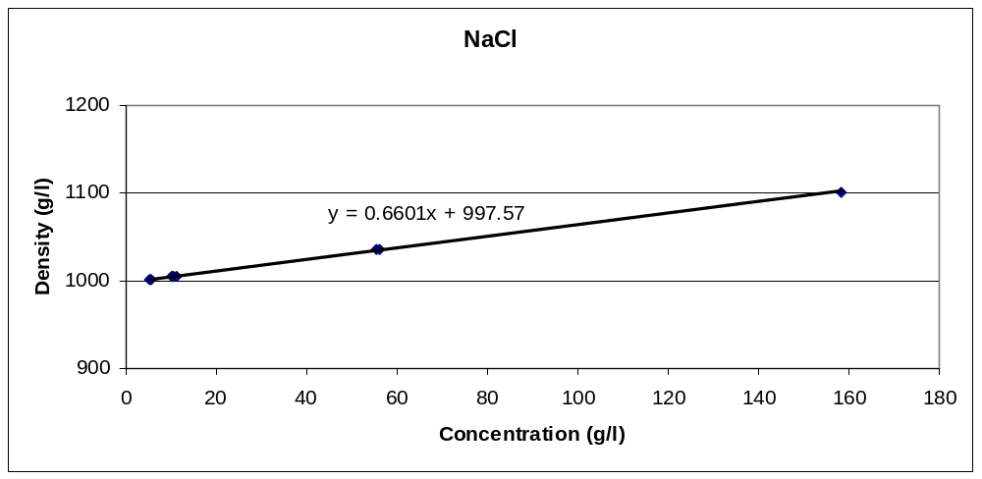

Slide 11
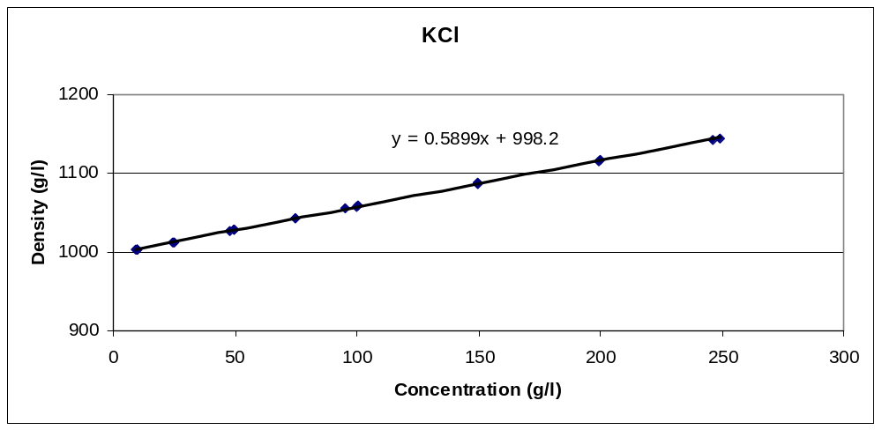

Slide 12
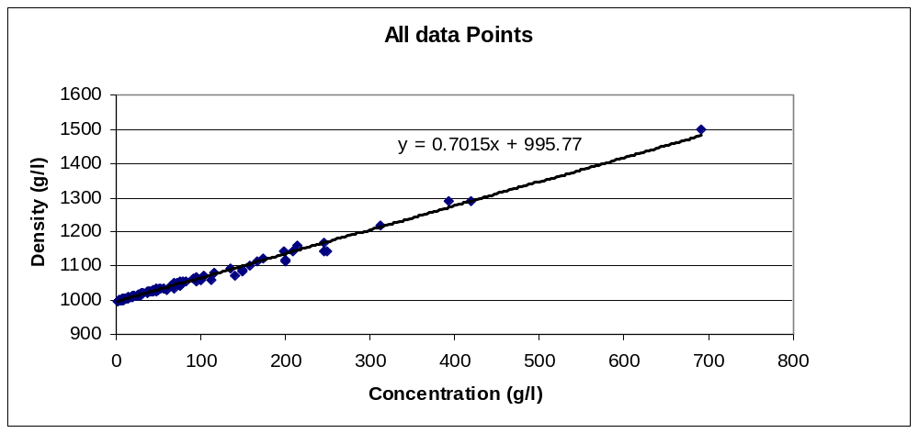
Data source: Baxter et al., 1911

Slide 13
Salts | Molecular weight | # samples | Regression Equation | Density Slope
LiCl | 42.4 | 12 | y = 0.5406x + 997.54 | 0.5406
NaCl | 58.46 | 8 | y = 0.6601x + 997.57 | 0.6601
KCl | 74.56 | 22 | y = 0.5899x + 998.2 | 0.5899
LiBr | 86.86 | 18 | y = 0.6972x + 997.56 | 0.6972
NaBr | 102.92 | 13 | y = 0.7278x + 998.48 | 0.7278
KBr | 119.02 | 16 | y = 0.6941x + 997.5 | 0.6941
LiI | 133.86 | 9 | y = 0.725x + 997.01 | 0.725
NaI | 149.92 | 9 | y = 0.7495x + 997.39 | 0.7495
KI | 166.02 | 8 | y = 0.7134x + 997.32 | 0.7134
ave |  | 115 |  | 0.677511
all data |  |  | y = 0.7015x + 995.77 | 0.7015
Data Source: Baxter, et al., 1911

Slide 14
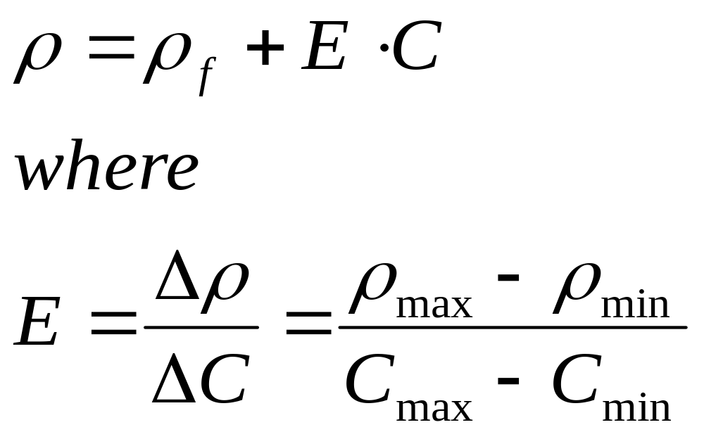
Density Calculation in SEAWAT

Slide 15
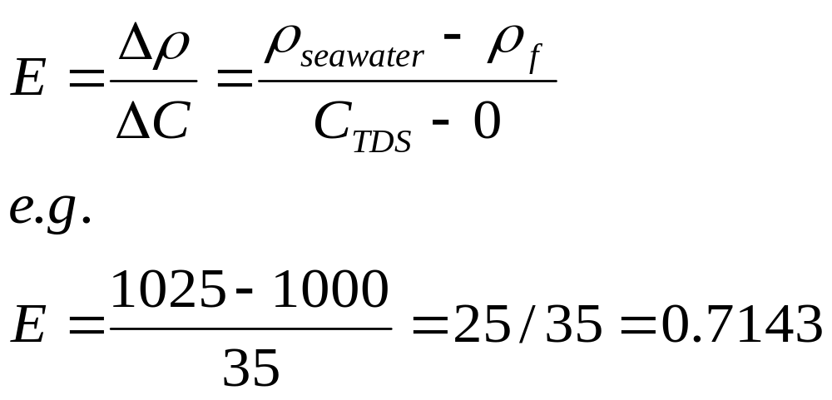
A Special Case of Density Slope

Slide 16
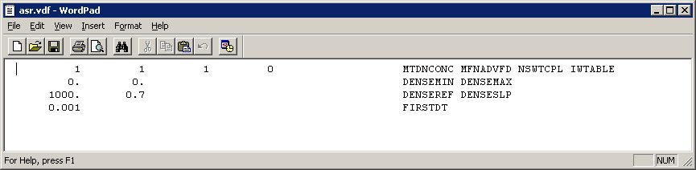
VDF File (cont.)
Example VDF file

Slide 17
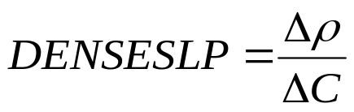

DENSEREF and DENSESLP
Concentration
units | freshwater | seawater
mg/L | 0 | 35,000
g/L | 0 | 35
lbs/ft³ | 0 | 2.188
relative | 0 | 1
Density
units | Freshwater (DENSEREF) | seawater
g/cm³ | 1 | 1.025
kg/m³ | 1000 | 1025
lbs/ft³ | 62.42 | 63.98
Example:
use concentration in mg/L and density in kg/m³
Density length units must be same as length units used for model grid, hydraulic conductivity, etc.

Slide 18
INPUT of CONCENTRATIONS
VERSION | TDS | Chloride
SEAWTA 1.2 | Yes | No
SEAWAT 2.1 | Yes | No
SEAWAT 2000 | Yes | Yes

Slide 19
Using Chloride Concentration
SEAWAT 2000
Chloride/TDS ratio is constant
Appropriate Density Slope

Slide 20
Chloride vs. TDS
TDS is preferred to be used for density calculation
Chloride concentration may be used for density calculation if the ratio of chloride concentration to TDS is relatively uniform (55%)

Slide 21
Compositions of “Typical” SEAWATER
Major Solutes | Concentration (mg/Kg) | Percentage (%)
Chloride | 19350 | 55.06
Sodium | 10760 | 30.62
Sulfate | 2710 | 7.71
Magnesium | 1290 | 3.67
Calcium | 411 | 1.17
Potassium | 399 | 1.13
Bicarbonate | 142 | 0.4
Bromide | 67 | 0.19
Others | 20 | 0.04

Slide 22
Field Measurements of Chloride and TDS Concentration
(Brevard, FL)
Well Name | Sample ID | Cl (mg/l) | TDS (mg/l) | Cl/TDS (%)
UF-1D | S-12 | 59 | 532 | 11.09
 | S-13 | 64 | 536 | 11.94
 | S-14 | 71 | 536 | 13.25
 | S-15 | 70 | 524 | 13.36
 | S-16 | 65 | 580 | 11.21
 | S-17 | 70 | 568 | 12.32
 | S-18 | 56 | 518 | 10.81
 | S-40 | 672 | 1372 | 48.98
 | S-25 | 882 | 2078 | 42.44
 | S-33 | 2717 | 5446 | 49.89
Data Source: BFA, 2001

Slide 23
Well Name | Sample ID | Cl (mg/l) | TDS (mg/l) | Cl/TDS (%)
UF-2S | S-1 | 124 | 556 | 22.30
 | S-2 | 183 | 668 | 27.40
 | S-3 | 390 | 1136 | 34.33
 | S-4 | 691 | 1772 | 39.00
 | S-5 | 833 | 2044 | 40.75
 | S-6 | 845 | 1984 | 42.59
UF-3D | S-32 | 49 | 412 | 11.89
 | S-33 | 52 | 384 | 13.54
 | S-34 | 64 | 388 | 16.49
 | S-35 | 55 | 400 | 13.75
 | S-36 | 55 | 388 | 14.18
 | S-37 | 52 | 376 | 13.83
 | S-27 | 74 | 896 | 8.26
 | S-25 | 134 | 694 | 19.31
 | S-23 | 2010 | 4372 | 45.97

Slide 24
How to estimate TDS
Specific conductance
Regressional Analysis of Chloride data

Slide 25
How to Predict Chloride Concentration
Multi-species Solute Transport
Proportional Calculation
Standard MODFLOW/MT3D Approach

